Slide 1

Bharadwaj Vavilikolanu (Lead)
Kiran Kumar Jonnada
Reddy Bhanu Prakash

Slide 2
About Lending Club
It is the world’s largest online credit marketplace.
They facilitates
personal loans,
business loans, and
financing for elective medical procedures.

Slide 3
What They Do
Borrowers access lower interest rate loans through a fast and easy online or mobile interface.
Investors provide the capital to enable many of the loans in exchange for earning interest.

Slide 4
Characteristics
We can get an instant quote in minutes with no impact to our credit score
If you’re investing, you can open an account in minutes. You’ll receive monthly payments of principal and interest, which you can withdraw or reinvest.
No matter what kind of loan you’re interested in, everything is done online, so the whole process is fast, convenient and private.
All loans facilitated by Lending Club are issued by a bank and subject to the same consumer protection, fair lending, and disclosure requirements as any other bank loan

Slide 5
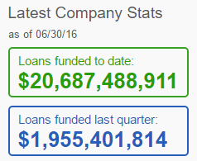
We operate fully online with no branch infrastructure, and use technology to lower cost and deliver an amazing experience. We pass the cost savings to borrowers in the form of lower rates and investors in the form of attractive returns

Slide 6
How it works for investors
Potential borrowers submit loan applications through Lending Club and Lending Club begins the screening process.
If approved, each loan is assigned a Grade between A and G based on borrower credit quality and underlying risk.
As an investor, you can then select and invest in Notes which correspond to fractions of these loans. By investing in at least 100 different Notes with different underlying borrowers, you may able to diversify your portfolio.⁴
As borrowers repay their loans, funds are deposited into your account and can be withdrawn or reinvested.

Slide 7
Why Data Warehousing?
A data warehouse is a system used for reporting and data analysis.
They also store historic data that helps in creating the trending based reports.
An ideal environment for data analysis and decision support
Current and Historical information on a customer risk information

Slide 8
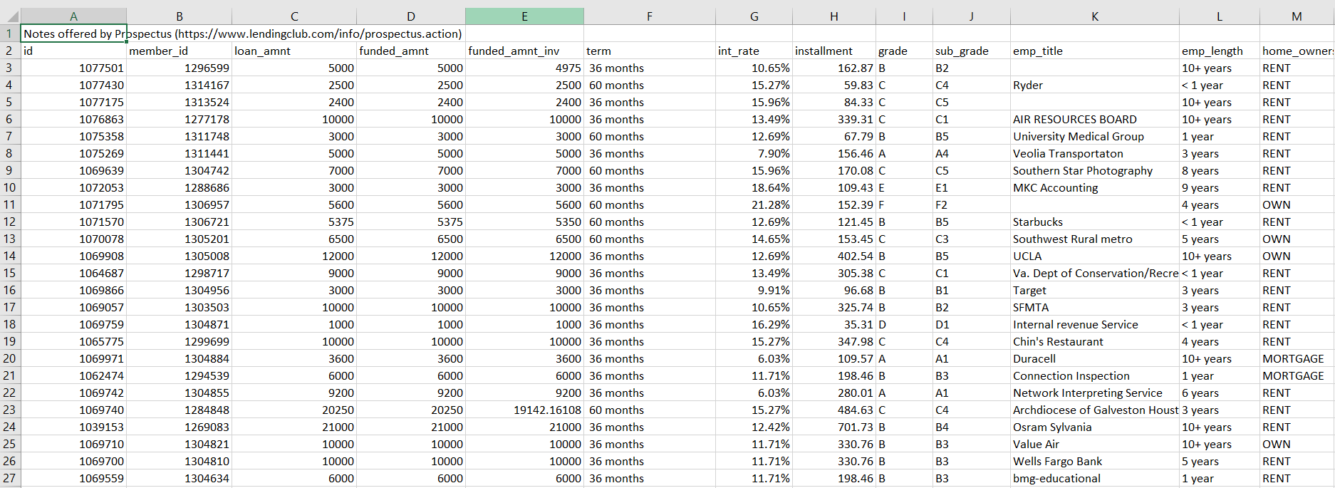
Sample Dataset

Slide 9
Dimension Tables
BorrowerDimension
BorrowerID(PK)
Borrower_Title
Borrower_Grade
Borrower_Homeowner
LocationID(FK)
Borrower_Zip_code
AnnualIncome
Loan
LoanID(PK)
LoanDescription
LoanTerm
Purpose
ApplicationType
TimeDimension
IssuedateID(PK)
Time_Day
Time_Month
Time_Year
Location
LocationID(PK)
State_name
A dimension table stores attributes, or dimensions, that describe the objects
in a fact table.

Slide 10
Fact Table
LoansFact
LoanID
BorrowerID
TimeID
LoanAmount
LoanAmountAlloted
InterestRate
The fact table lists events that happen in the company (or at least the events that
we want to analyze). The dimension tables list the factors (Borrower, Time, Investor etc.,)
by which we want to analyze the data.

Slide 11
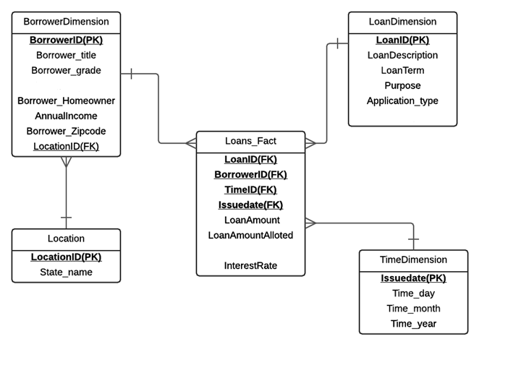
Snow Flake Schema

Slide 12
Reports:
1. Report based on Grade.
2. Report based on Purpose.
3. Report based on State.

Slide 13
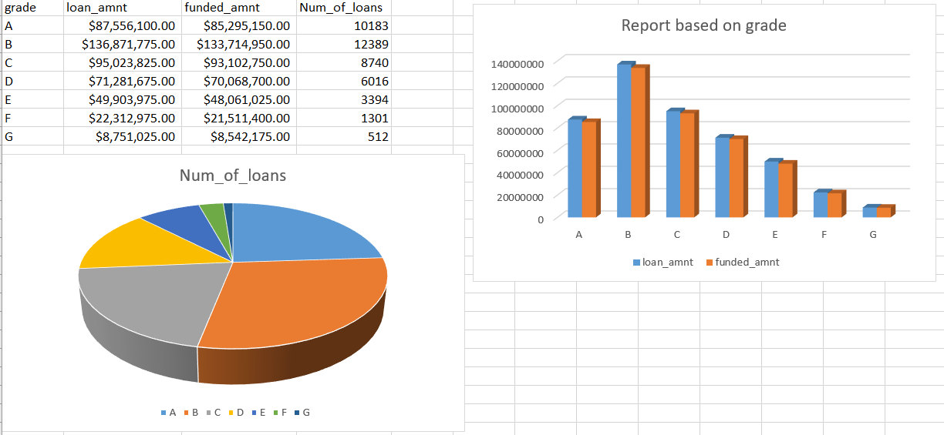

Slide 14
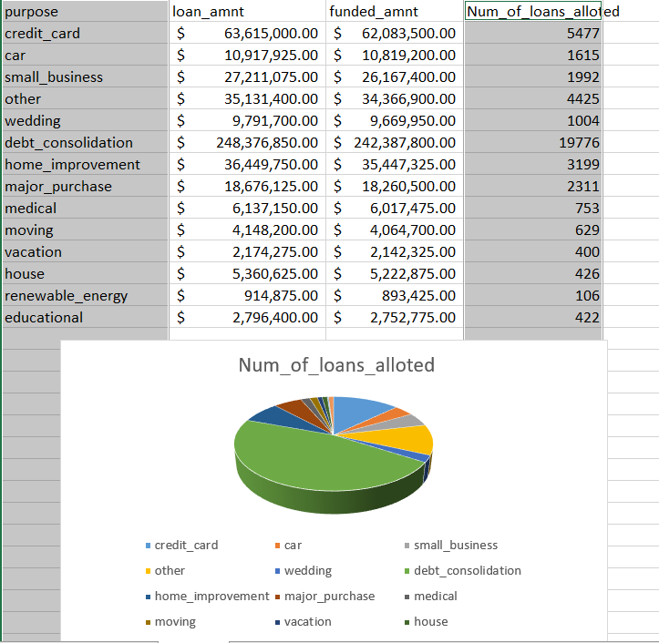

Slide 15
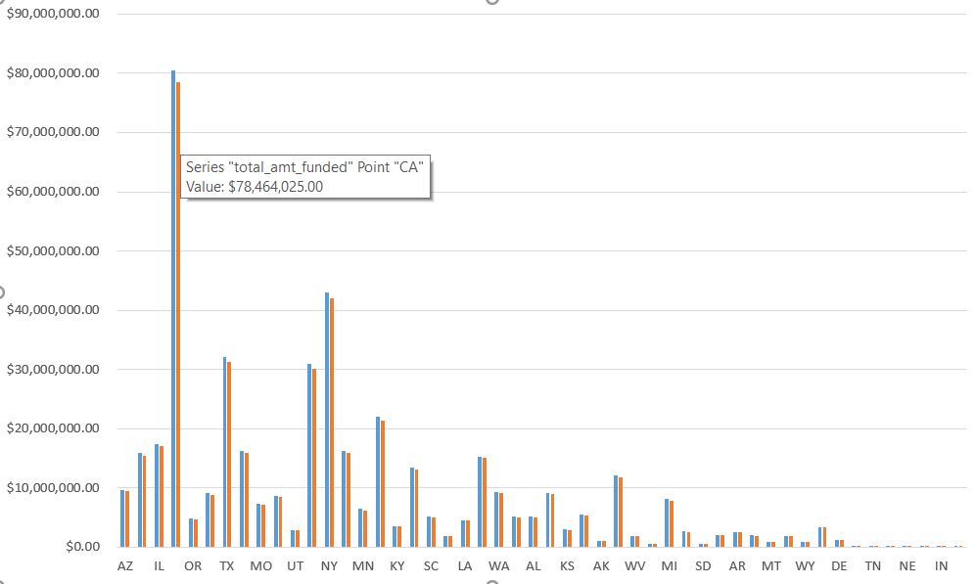

Slide 16


